Slide 1

Employee Performance and Growth Analysis
By Power Bi
Presented by: Suman Saha — Data Analyst
Comprehensive workforce and sales insights spanning 2012–2024, driving strategic decisions for organizational excellence and sustainable growth.

Slide 2
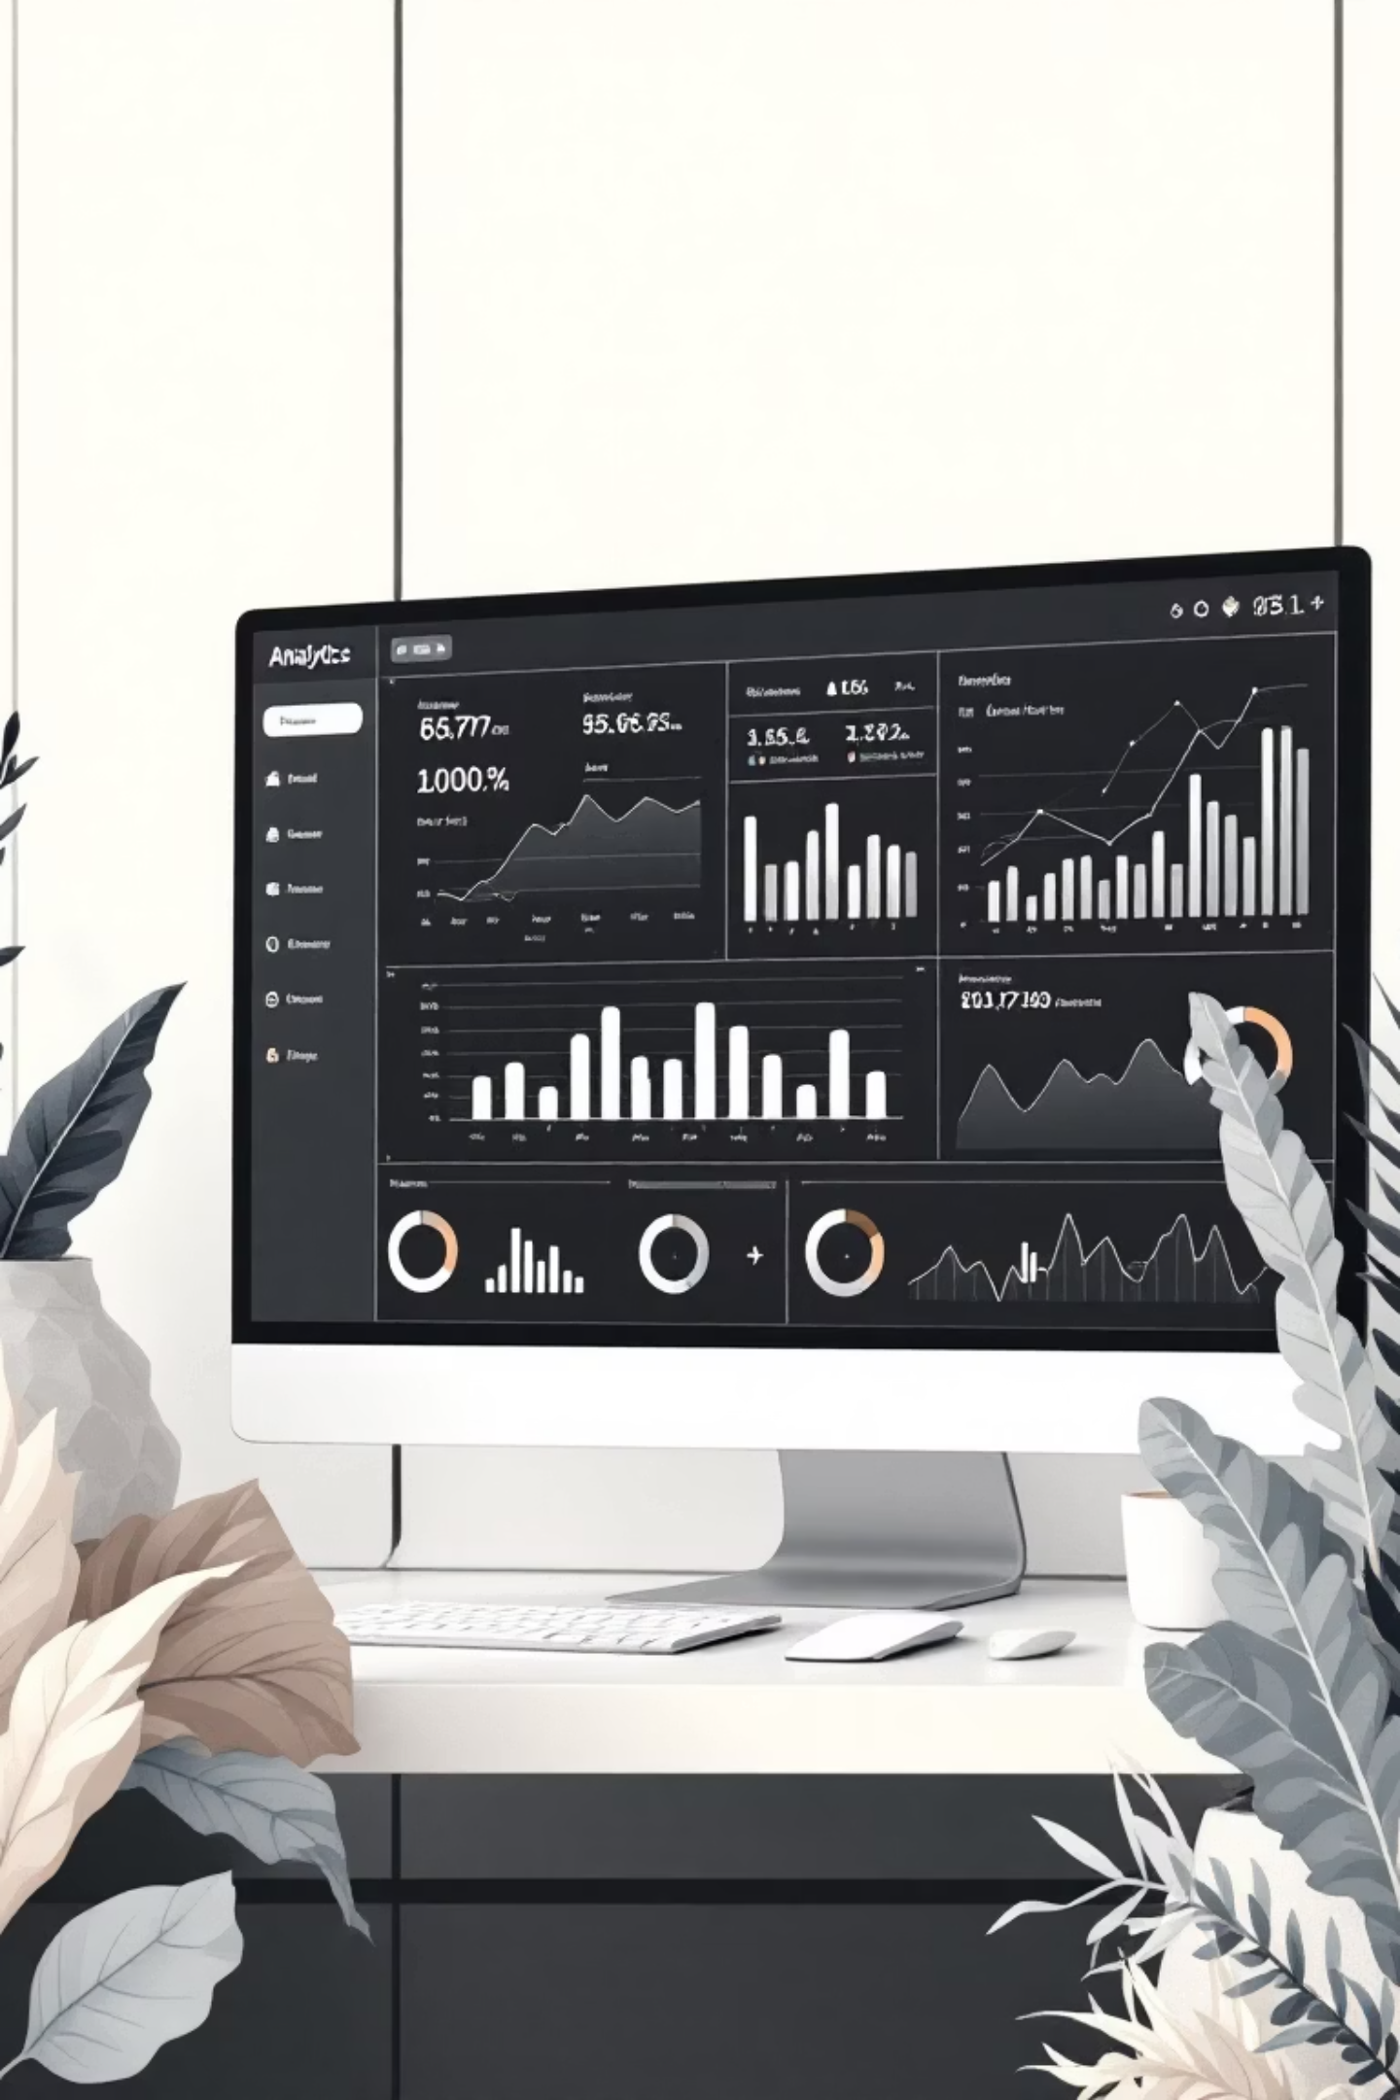
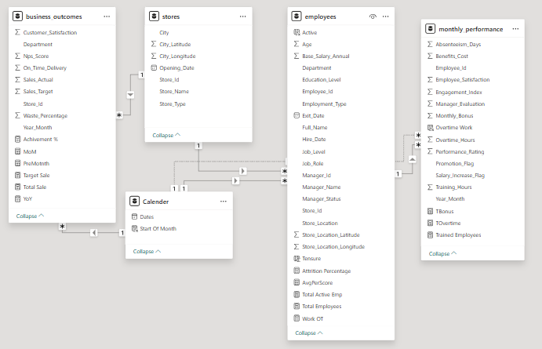
Strategic Analysis Framework
Data Modeling
Key Business Questions
Performance Drivers
Store-level sales achievement and target performance
How are employees and departments performing against benchmarks?
Operational efficiency improvements across locations
What factors drive training effectiveness, satisfaction, and retention?
Customer satisfaction and Net Promoter Score trends
Which departments face the highest attrition challenges?
Strategic opportunities for productivity enhancement
Who are our most effective leaders and managers?

Slide 3
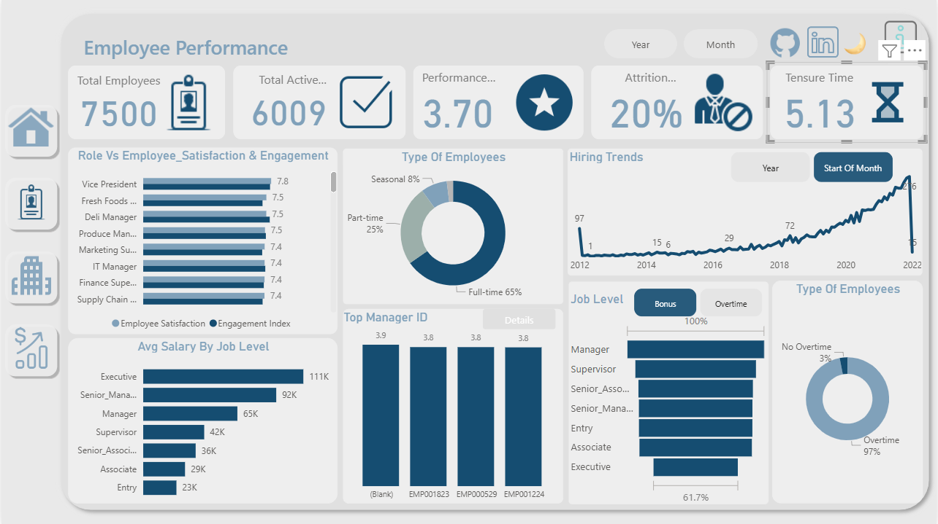

Employee Dashboard

Slide 4

Workforce at a Glance
7.5K
6,009
3.70
20%
Total Employees
Active Workforce
Avg Performance Rating
Attrition Rate
Complete workforce across all locations and departments
Currently employed team members
Annual employee turnover requiring attention
Strong baseline performance across organization
5.13
Average Tenure
Years of employee retention and loyalty

Slide 5
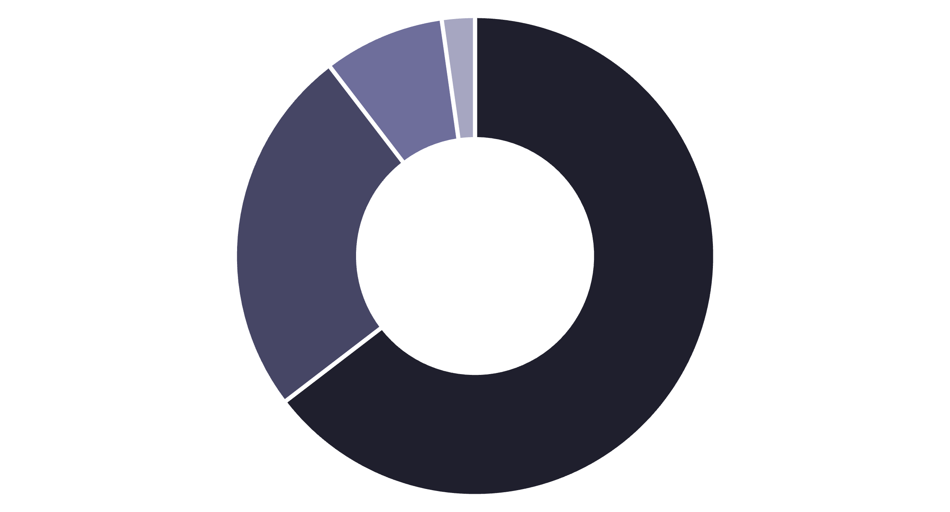
Workforce Composition & Employment Types
Full-time
Part-time
Seasonal
Other
Our workforce demonstrates a healthy balance with full-time employees forming the stable core, supported by part-time flexibility and seasonal capacity during peak periods. This strategic mix enables responsive operations while maintaining consistent service quality.

Slide 6




Employee Satisfaction Leaders
Vice President
Fresh Foods Manager
Satisfaction Score: 7.8
Satisfaction Score: 7.5
Executive leadership demonstrates highest engagement and organizational alignment
Department managers show strong connection to operational success
Deli Manager
Produce Manager
Satisfaction Score: 7.5
Satisfaction Score: 7.5
Customer-facing leadership exhibits high job satisfaction
Store-aligned roles maintain consistently positive engagement
Key Insight: Leadership and store-aligned operational roles demonstrate the strongest satisfaction and engagement levels, indicating effective management structures and clear role definition at these levels.

Slide 7





Compensation Structure by Level
Entry Level
Supervisor
Manager
$23K average — Foundation workforce with growth potential
$42K average — First-line leadership managing daily operations
$65K average — Mid-level management driving departmental success
Senior Manager
Executive
$92K average — Strategic leaders overseeing multiple functions
$111K average — Top-tier leadership setting organizational direction
Top Performing Managers
Our compensation structure reflects clear career progression pathways with competitive rates at each level, supporting talent retention and motivation across the organization.
EMP001823 — Performance Rating: 3.9
EMP000529 — Performance Rating: 3.8
EMP001224 — Performance Rating: 3.8

Slide 8
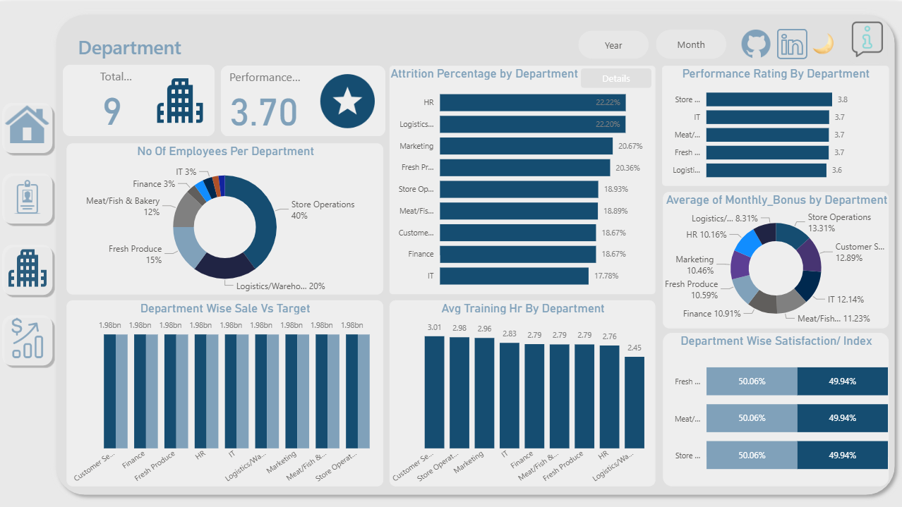
Department Dashboard

Slide 9





Department Performance Overview
Store Operations
Rating: 3.8 — Best performing department
40% of workforce | Leading customer service excellence
Logistics/Warehouse
Rating: 3.6 — Improvement opportunity
20% of workforce | Critical supply chain function
Fresh Produce
Rating: 3.7 — Solid performance
15% of workforce | Quality-focused operations
Meat/Fish/Bakery
Rating: 3.7 — Strong specialty departments
12% of workforce | Skilled artisan teams
Nine departments drive organizational success with an average rating of 3.70. Store Operations leads performance metrics while Logistics presents strategic improvement opportunities.

Slide 10

Attrition, Training & Bonus Investment
Highest Attrition
Training Investment
Bonus Distribution
22.22%
Customer Service: 3.01 hours average
Store Operations: 13.31% of salary
Store Operations: 2.98 hours average
Customer Service: 12.89% of salary
Human Resources
Focus: Customer-facing excellence
Strategy: Reward frontline performance
22.20%
Logistics/Warehouse
20.67%
Marketing
Critical Finding: HR and Logistics experience the highest turnover at over 22%, requiring targeted retention strategies and engagement programs to reduce costly attrition in these essential functions.

Slide 11
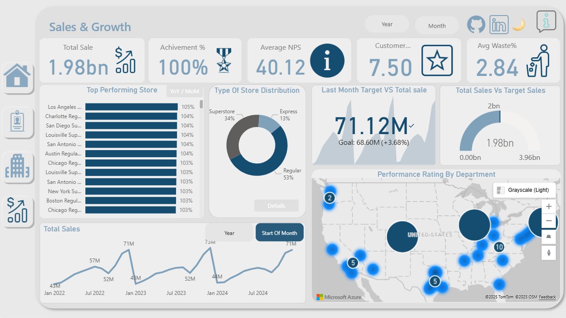
Sales Dashboard

Slide 12
Sales Performance Excellence
$1.98B
100%
40.12
7.50
Total Annual Sales
Target Achievement
Net Promoter Score
Customer Rating
Complete revenue across all stores and channels
Meeting organizational sales goals
Strong customer loyalty and satisfaction
Above-average service quality perception
2.84%
Average Waste
Efficient inventory and operations management
Top Performing Stores
Store Format Mix
Recent Performance
Los Angeles: 105% of target
Regular Stores: 53%
Last Month Sales: $71.12M
Charlotte: 104% of target
Superstores: 34%
Monthly Target: $68.60M
San Diego: 104% of target
Express Locations: 13%
Achievement: +3.68% above goal
Louisville: 104% of target
Diversified footprint optimizing market coverage
Consistent monthly overperformance demonstrates operational excellence
San Antonio: 104% of target

Slide 13



Strategic Recommendations for Growth
Human Resources Priorities
Deploy targeted engagement programs in HR and Logistics to reduce 22% attrition
Increase training investment in lower-performing departments
Optimize overtime policies—currently 97% have no overtime hours
Develop career pathways to improve retention in high-turnover roles
Departmental Excellence
Implement performance improvement initiatives in Logistics/Warehouse (3.6 rating)
Replicate Store Operations best practices (3.8 rating) across departments
Enhance satisfaction efforts in departments scoring below 7.3 index
Increase training hours in underperforming areas
Sales & Store Optimization
Expand successful store formats—Regular (53%) and Superstore (34%) showing strong results
Apply top-performing store strategies (Los Angeles, Charlotte, San Diego) to underperforming regions
Maintain rigorous monthly target tracking to sustain +3.68% overachievement
Leverage 40.12 NPS and 7.50 customer rating to drive competitive advantage

Slide 14
Thank You
Any Questions?

